Slide 1

Module 3:
The Myth of Neutrality and
Common
Ground

Slide 2
Neutrality Myth + Common Ground
We are still focusing on the POV level

Slide 3
Knowledge Flowchart
Basic Assumptions (common experience)
  |(induction, sense perception)
Ultimate Assumption + Authority (God or self)
|(determines our Point of View)
Point of View
|(contain a web of beliefs)
Beliefs
|(used to determine...)
Facts/Evidence/Proof/Truth
|(Is where many people incorrectly start)
Notes:
The closer to the top you are, the more basic
your assumptions are
The further to the bottom you are,
the more assumptions you have
which are built on top of one another

Slide 4
Neutrality Myth + Common Ground
We are still focusing on the POV level
People often don't think they have a POV

Slide 5
Oftentimes...
People act as if they are neutral
In that they have no POV at all

Slide 6
Ever heard someone say?
Let's
  Put our biases aside
  Look at this objectively
  Stick to the facts
  Trust the science
  Don’t talk politics and religion
  See what everyone else thinks
Then you have experienced
the myth of neutrality

Slide 7
Neutrality Myth + Common Ground
We are still focusing on the POV level
People often don't think they have a POV
No one is neutral

Slide 8



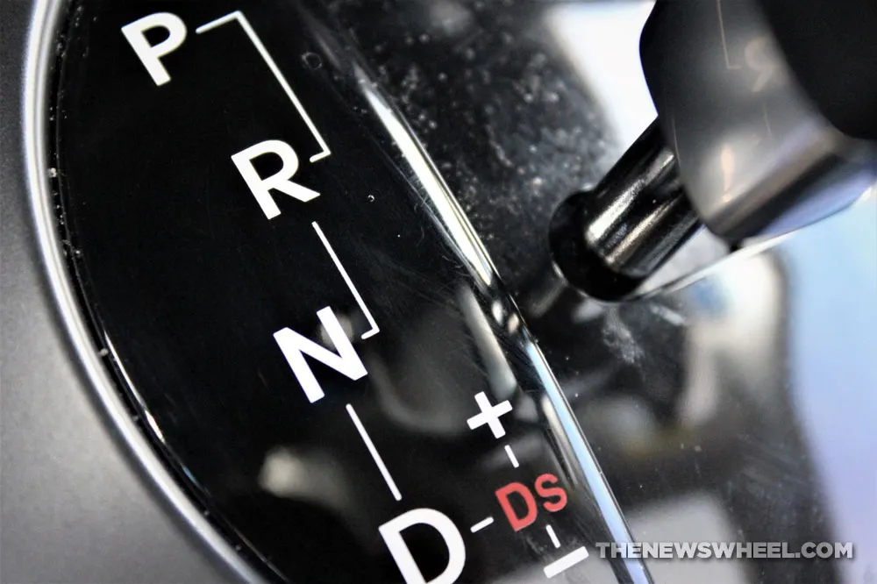
The Myth of Neutrality
No One is Neutral
Neither should you be
Our
POV
Interprets
The
Data

Slide 9
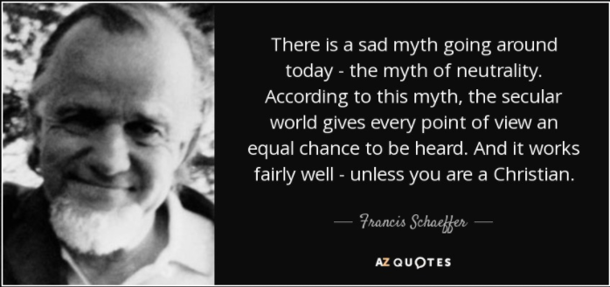

Slide 10
Neutrality Myth + Common Ground
We are still focusing on the POV level
People often don't think they have a POV
No one is neutral
  With God's blessings

Slide 11
Does the unbeliever
Thank God for his life, breath, and all he has?
Either you do or you don’t
There is no in-between
Romans 1
24. "The God who made the world and all things in it, since He is Lord of heaven and earth, does not dwell in temples made with hands;
25. nor is He served by human hands, as though He needed anything, since He Himself gives to all [people] life and breath and all things;

Slide 12
Neutrality Myth + Common Ground
We are still focusing on the POV level
People often don't think they have a POV
No one is neutral
  With God's blessings
  With evidence

Slide 13
We know that
People come to different conclusions
Even when presented with the same evidence.
Are we hopelessly at a stalemate?

Slide 14
How do we bridge the POV gap?
Common ground

Slide 15
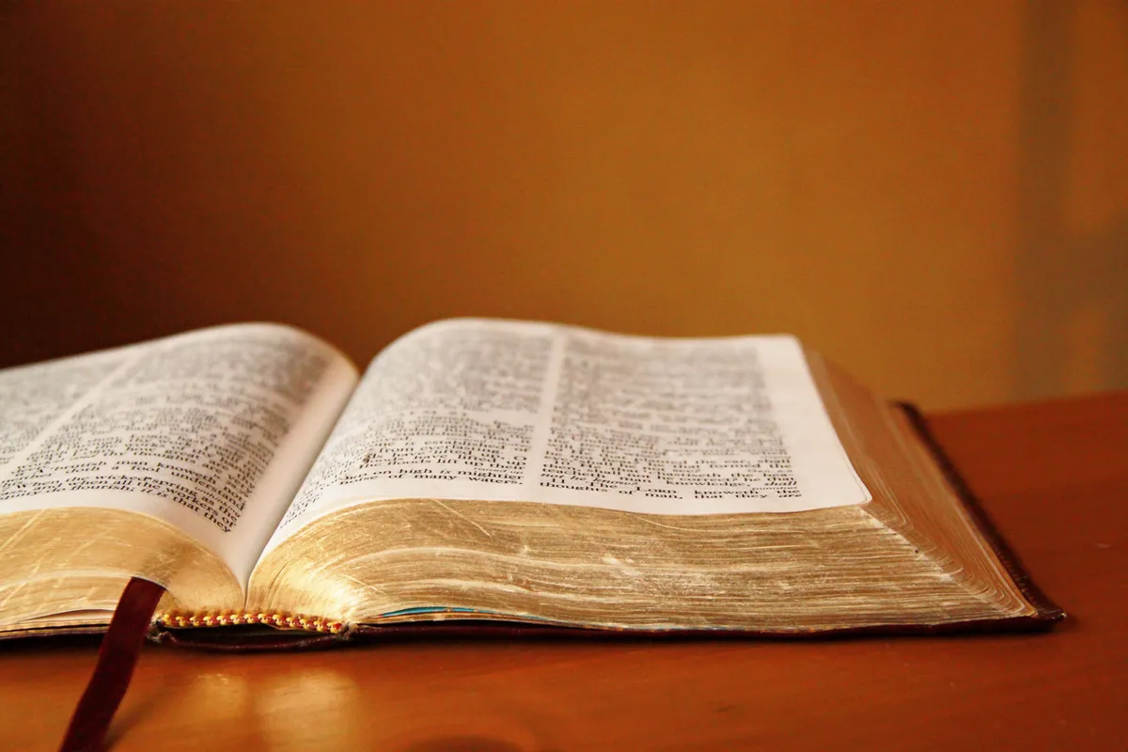
Before the unbeliever opens his mouth, you already know things about him...

Slide 16

The common ground we all stand on
Genesis 1:27
We are all imagers of God.
Ecclesiastes 3:11
God set eternity in our hearts.
- We know our days are numbered and seek purpose.
Psalm 19:1
The heavens are telling of the glory of God
(creation and design).
Romans 1:21
We know God and perceive His attributes
(logic, love, human dignity, purpose, justice, free will).

Slide 17
How do we bridge the POV gap?
Common ground
The unbeliever already knows God

Slide 18

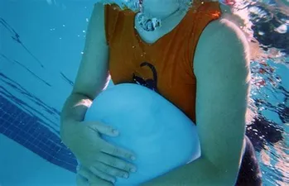
The Unbeliever Suppresses knowledge of God
Romans 1:18. For the wrath of God is revealed from heaven against all ungodliness and unrighteousness of people who suppress the truth in unrighteousness,
19. because that which is known about God is evident within them; for God made it evident to them.
Notes:
-Supression of the truth for the unbeliever is like holding a beach ball under water. It will only come to the surface when you stop suppressing it.
-The evidence of God's existence is presented to the unbeliever every day like whack-a-mole. It's our job to point them out
-There is a certain sense in which the unbeliever knows God, even if he claims to be an atheist.
The next verse tells us how the unbeliever knows God

Slide 19
What is known about God?
Romans 1: 20. For since the creation of the world His invisible attributes, that is, His eternal power and divine nature, have been clearly perceived, being understood by what has been made, so that they are without excuse.
21. For even though they knew God, they did not honor Him as God or give thanks, but they became futile in their reasonings, and their senseless hearts were darkened.
Notes:
20. - Humans are able to perceive:
Moral value – human dignity – value of human life
We Image God every time we sense injustice or desire to love others
Laws of logic (train)
Creation (eternal power)
Regularity of nature
-Without Excuse is – without a defense.
An-apologia
-First, we need to define some terms

Slide 20
How do we bridge the POV gap?
Common ground
The unbeliever already knows God
Why does POV matter?
  The starting point matters

Slide 21


The Starting Point
Starting with man or God as your authority results in vastly antithetical/opposite worldviews.
There is no middle ground
If you start a math problem wrong, you end with the wrong answer
Likewise, your starting point always determines your destination when assessing facts.

Slide 22
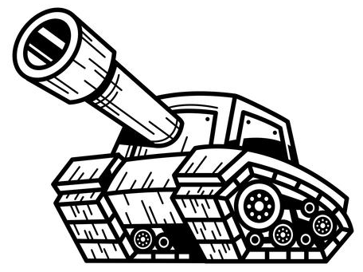

Bring out the Big Guns
Do not be bullied
into not using
your ultimate authority (God).
You know the unbeliever will bring his out.
(self)
As long as the unbeliever relies
on his false,
self-attesting authority,
he will always end up
right where he started,
-in opposition to God
with his self-attesting
opinions

Slide 23
How do we bridge the POV gap?
Common ground
The unbeliever already knows God
Why does POV matter?
  The starting point matters
  Not all authorities are equal

Slide 24

Examples of Authorities
What website (authority) did you get that from?
We recognize that facts need a reference point.
Whether a politician has a
"D" or "R" behind their name
- not all authorities are equal and we know it
-Does the Christian
and unbeliever have
common ground to bridge
the divide?...
Notes:
There is no "just the facts ma'am".
There is no such thing as a 'brute fact'.
All believs have basic assumptions behind them; that's why a politician can be called a savior to some and devil incarnate to others.

Slide 25
How do we bridge the POV gap?
Common ground
The unbeliever already knows God
Why does POV matter?
  The starting point matters
  Not all authorities are equal
Why do we oppose man-made POVs?

Slide 26

Do not be deceived by man-made, false knowledge
There is no secret man-made knowledge that supercedes the knowledge that comes from God
Colossians 2: 2-3. In Christ are hidden all the treasures of wisdom and knowledge.
v.8 "See to it that there is no one who takes you captive through philosophy and empty deception in accordance with human tradition, in accordance with the elementary principles of the world, rather than in accordance with Christ“.
Notes:
Question 1:
Does a person who is deceived realize he has been tricked?
No
Question 2:
What is a philosophy of human tradition which is not in accordance with Christ?
-You can justify truth in morality apart from Christ.
-Materialism
-Polytheism
-Evidence with the wrong authority and starting point is how the world thinks

Slide 27
How do we bridge the POV gap?
Common ground
The unbeliever already knows God
Why does POV matter?
  The starting point matters
  Not all authorities are equal
Why do we oppose man-made POVs?
How do we oppose them?

Slide 28
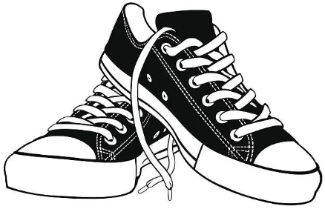
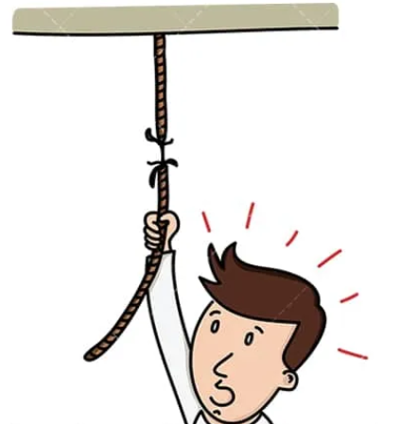
Point them to their feet
Can his POV
Bear the weight
Of his beliefs?

Slide 29

Recall Justification
If your belief contradicts
Your own POV
based on its own
standards
Then you have no good
reason to believe it
All humans have the same common ground
Recognize when you are on that territory

Slide 30
How do we bridge the POV gap?
Common ground
The unbeliever already knows God
Why does POV matter?
  The starting point matters
  Not all authorities are equal
Why do we oppose man-made POVs?
How do we oppose them?
An Example

Slide 31
You must ask questions
To find out which POV your friend holds
  Materialism
  Dualism
  Polytheism
  Monotheism
In the following example, we determined a form of materialism as his POV
We summarize the views.
Tactics for appoaches are discussed later.

Slide 32

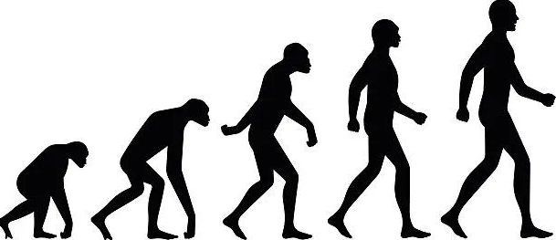


A key example
(i.e.) The Orlando night club mass shooting:
The Christian has a grounding/justification in God's revelation to call that evil.
- The unbeliever does not.
The materialist believes we are in a purposeless, meaningless universe and are just star dust.
All there is is time and chance, acting on matter.
Notes:
Only the Christian worldview gives you a justification(good reason) to say that murder is wrong
-Otherwise, anything can be true if enough people or societies/groups of people say it,
which we know is wrong
(that's a logical fallacy called the bandwagon appeal)

Slide 33

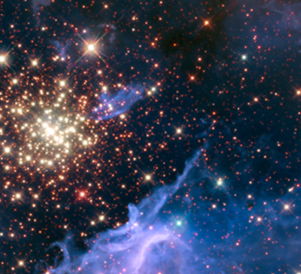
Continued...
Who cares what star dust does to star dust
Does anyone cry when a rock falls off a cliff?
Why is the unbeliever not consistent with his worldview?....

Slide 34


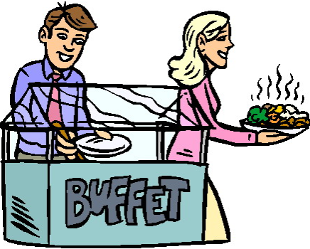

Every time an unbeliever cries over injustice, they demonstrate they are image bearers of God; they act as if they know God by how they behave.
"I don't need God to know that murder is wrong?"
Human value is not a neutral value. The unbeliever must borrow from the Christian worldview.
-------->
Notes:
Only the Christian worldview gives you a justification(good reason) to say that murder is wrong
-Otherwise, anything can be true if enough people or societies/groups of people say it,
which we know is wrong
(that's a logical fallacy called the bandwagon appeal)

Slide 35


Without the Christian God
The unbeliever has no good reason to call
-children with bone cancer
-mass shootings
-childhood hunger
-suicide
as bad
There is no moral capital to spend with
He must step out of
his worldview
to steal from the Christian worldview
to tug your heartstrings by claiming
that God is evil

Slide 36
Human value
Is a common ground area that our materialist friend takes for granted
(God's invisible attributes perceived)
He does not give thanks to God for what he attributes to blind chance,
Which is a belief we will later demonstrate
a materialist has no good reason to believe
Based on his own POV

Slide 37
Comprehension Questions
What is the myth of neutrality?
Recall the example which shows people believe authority in truth matters
What do our assumed starting points determine?
What are the two competing authorities?
What do our assumed starting points determine?
Notes:
-myth of neutrality:
There are brute facts that you must agree to. We can use our authority of self, but you are not allowed to use your authority, the Christian God
-authority – news source matters
-starting point determines where we end up
-Assumed starting points determine where we end up

Slide 38

Myth of Neutrality
Common ground
Suppressed knowledge
Your starting point
The inability of unbelievers to live
consistent with their worldview

Slide 39

Next Module:
How to Reason with Unbelievers

Slide 40

End of Module 3
Questions?

